Slide 1

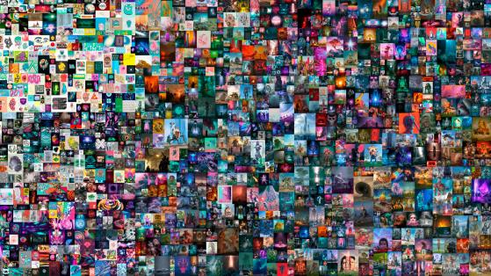
NFT
Own your Asset

Slide 2
Contents
Overview - Definition - Market
Comparo - NFT vs FT
Standards - ETH vs EOS
Applications

Slide 3
Overview

Slide 4


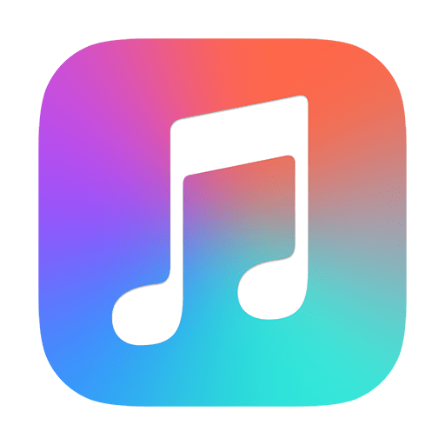

Definition
Non-fungible tokens (NFTs), also often referred to as “crypto collectibles” or “digital assets”.
Fungibility: the ability of an asset to be exchanged or substituted with similar assets of the same value.

Slide 5
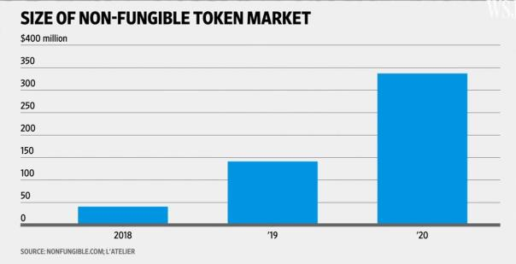
Market
NFTs are one of the key building blocks of a new, blockchain-powered digital economy.

Slide 6
Comparo

Slide 7

NFT vs FT
Unlike cryptocurrencies, where all tokens are created equally, non-fungible tokens are each unique and limited in quantity.

Slide 8
Standards

Slide 9


ETH
EOS
ERC-721
ERC-1155
SimpleAssets
AtomicAssets

Slide 10
Applications

Slide 11
Cards are currently only being used as collectibles.
House property can be built as a NFT whose ownership can’t be altered w/o prior permission unlike today’s situation.
Music piracy is all over. So, the copyrights can be preserved.
Non-digital/digital paintings can be uniquely owned.

Slide 12

THANKS

